Slide 1
Car accident Severity
By Shengyu Wu

Slide 2
Introduction
Car accidents have a significant impact on individuals, their families and the nation. About 4.4 million people in US were injured seriously enough to require medical attention in crashes last year. Therefore, if there was an algorithm that can predict severity of car accidents, it could be efficient and faster for police to arrive the accident scene and give right help.
This project is attempting to classify varies factors that will cause the accidents and predict the level of severity by leveraging data collected from different kinds of car accidents.

Slide 3
Data Cleaning
Drop unimportant dataset, then the columns we left are：
'SEVERITYCODE', 'X', 'Y', 'LOCATION’,
'COLLISIONTYPE’, 'PERSONCOUNT’,
'VEHCOUNT', 'JUNCTIONTYPE’,
'INATTENTIONIND', 'WEATHER’,
'ROADCOND’, 'LIGHTCOND', 'SPEEDING'

Slide 4
Methodology
Illustrate proportional data under different conditions
WEATHER
LIGHTCOND
ROADCOND
Clear 111135
Raining 33145
Overcast 27714
Unknown 20172
Snowing 907
Other 832
Fog/Smog/Smoke 569
Sleet/Hail/Freezing Rain 113
Blowing Sand/Dirt 56
Severe Crosswind 25
Partly Cloudy 5
Daylight 116137
Dark - Street Lights On 48507
Unknown 18643
Dusk 5902
Dawn 2502
Dark - No Street Lights 1537
Dark - Street Lights Off 1199
Other 235
Dark - Unknown Lighting 11
Dry 124510
Wet 47474
Other 20222
Ice 1209
Snow/Slush 1004
Standing Water 115
Sand/Mud/Dirt 75
Oil 64

Slide 5
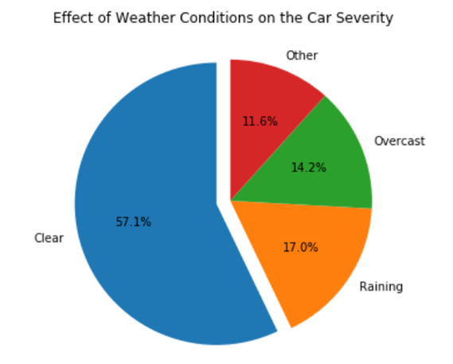
Data Visualization
Effect of Weather Conditions on the Car Severity

Slide 6
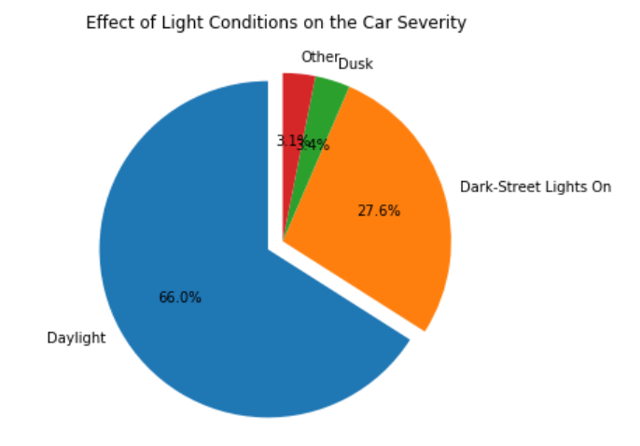
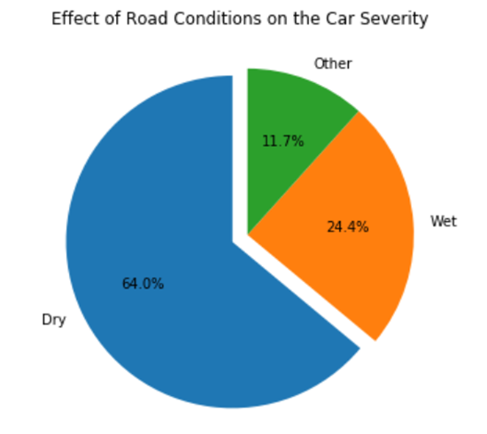
Effect of Light Conditions on the Car Severity
Effect of Road Conditions on the Car Severity

Slide 7
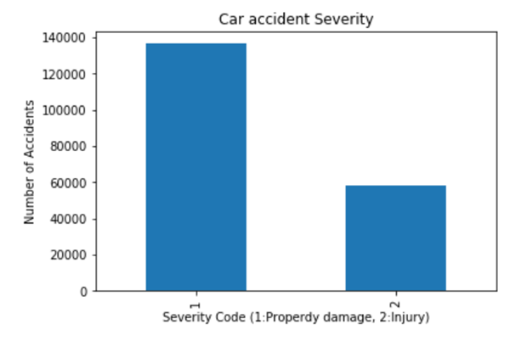
Severity Type
We can see that the numbers of severity code are unbalanced. Most accident data collected comes from property damage accident

Slide 8
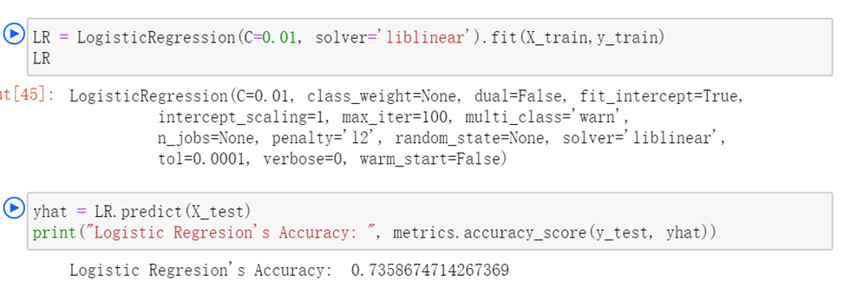
Logistic Regression

Slide 9
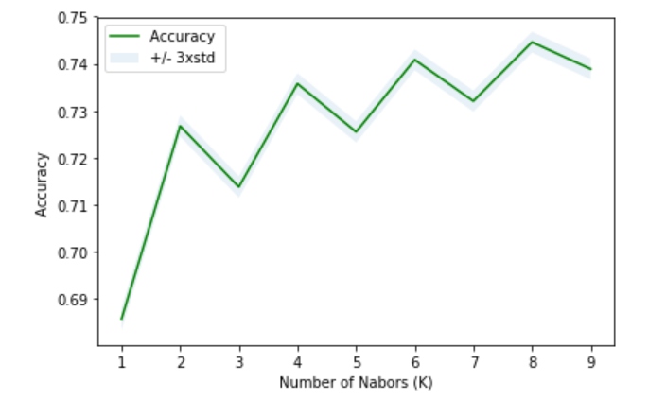
K nearest neighbor (KNN)
Range of accuracy for different number of Ks
The best K equals 8
With accuracy at around 0.74

Slide 10
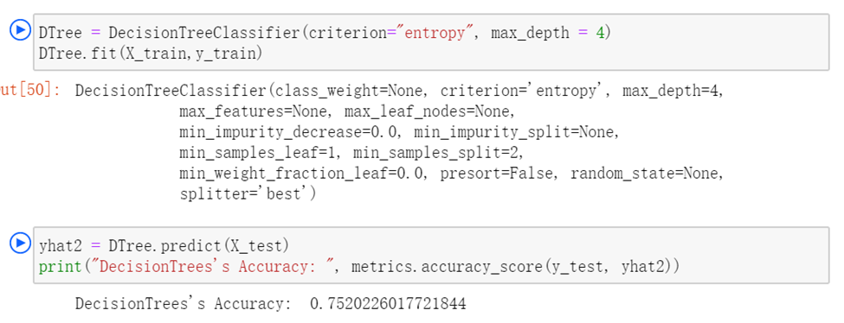
Decision Tree

Slide 11
Results
Algorithm | Jaccard | F1-Score
Logistic Regression | 0.7520 | [0.8490, 0.3062]
KNN | 0.7389 | [0.8261, 0.4758]
Decision Tree | 0.7520 | [0.8490, 0.3062]

Slide 12
Discussion
Based on the result, it can be considered that if we incorporate with more factors, the accuracy might be higher. In addition, we observed that there are two types of severity, one of them was property damage and another was injury. Since the data was unbalance between these two types, the result would be different after we balance the dataset or predicting severity based only on accidents that cause injury.

Slide 13
Conclusion
In this study, we found that more than half of car accidents happen on dry road during clear weather days under daylight, which was the most common condition in daily life. Other than that, more than 15 percent of accidents happen in rainy days on wet and dark street with lights on. Explanatory data analysis has done to give insight into the relationship between the features and the severity of the accidents. For improving the accuracy of this machine learning process, we could collect more data on speeding and add more features that should be relevant to the accidents such as age of driver, years of driving license and so on.

Slide 14
Thank You

